Slide 1
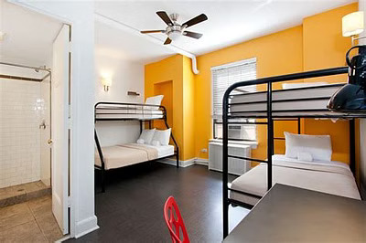
Eazy PG
Discover Your Ideal PG:A Click Away
"Simplify your search for the perfect PG or hostel—find, review, and choose with confidence."

Slide 2
Search Bar
Property Review
Listing Preferences

